Slide 1
The UML is a language for
· Visualizing
· Specifying
· Constructing
· Documenting
the artifacts of a software-intensive system.

Slide 2
The vocabulary of the UML encompasses three kinds of building blocks:
1. Things
2. Relationships
3. Diagrams
There are four kinds of things in the UML:
1. Structural things
2. Behavioral things
3. Grouping things
4. Annotational things

Slide 3
In all, there are seven kinds of structural things:
Classes
Interfaces
Collaborations
Use cases
Active classes
Components
Nodes

Slide 4
In all, there are two primary kinds of behavioral things:
Interaction
state machine
In all, there is one primary kind of grouping thing:
Package
There is one primary kind of annotational thing:
note

Slide 5
There are four kinds of relationships in the UML:
1. Dependency
2. Association
3. Generalization
4. Realization
the UML includes nine diagrams:
1. Class diagram
2. Object diagram
3. Use case diagram
4. Sequence diagram
5. Collaboration diagram
6. Statechart diagram
7. Activity diagram
8. Component diagram
9. Deployment diagram

Slide 6
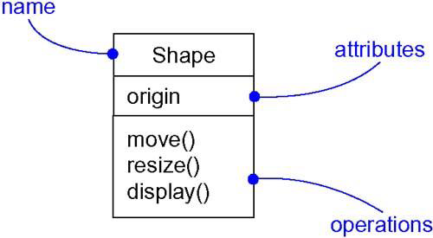
Classes

Slide 7
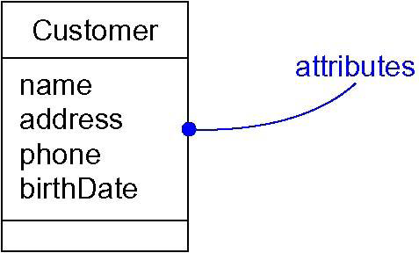
Attributes

Slide 8
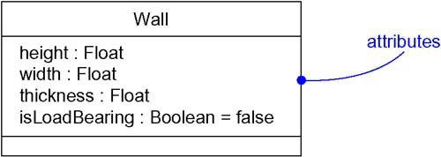
Attributes and Their Class

Slide 9
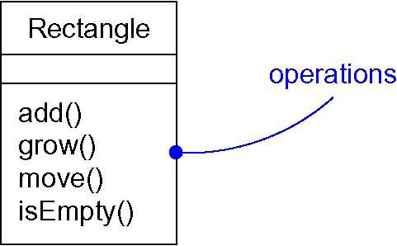
Operations

Slide 10
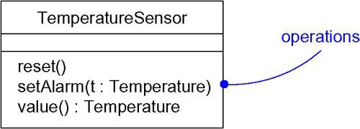
Operations and Their Signatures

Slide 11
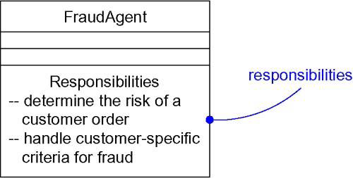
Responsibilities

Slide 12
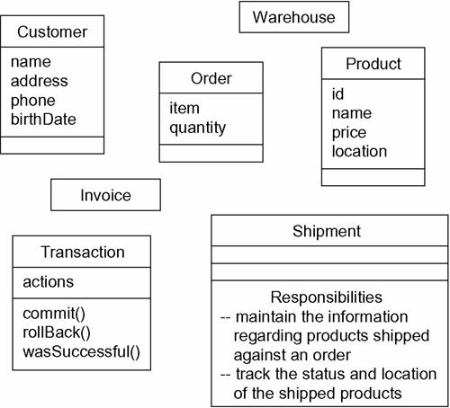
Modeling the Vocabulary of a System

Slide 13
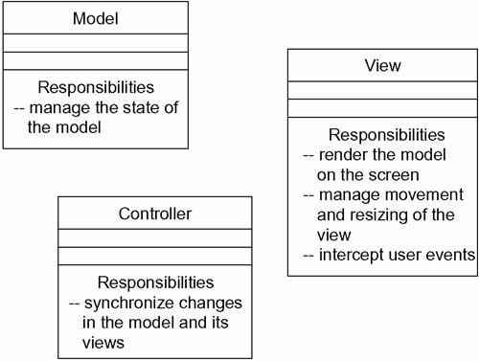
Modeling the Distribution of Responsibilities in a System

Slide 14
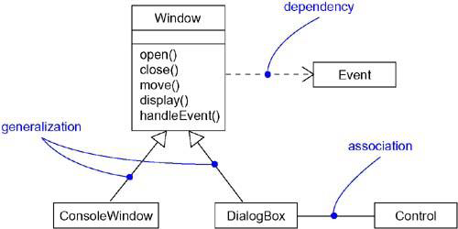
Relationships

Slide 15
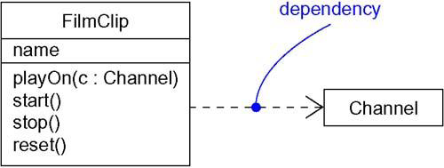
Dependencies

Slide 16
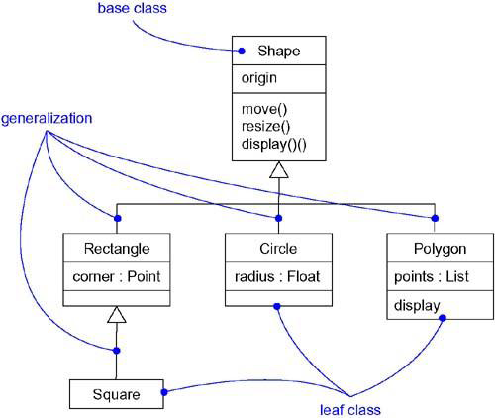
Generalization

Slide 17
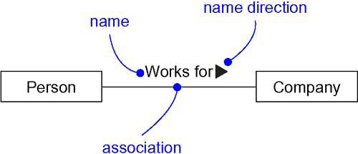
Association Names

Slide 18
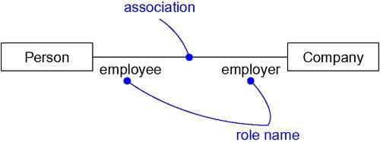
Roles

Slide 19
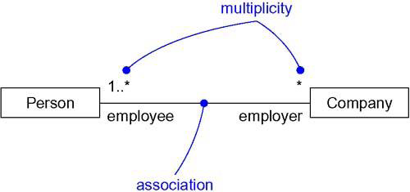
Multiplicity

Slide 20
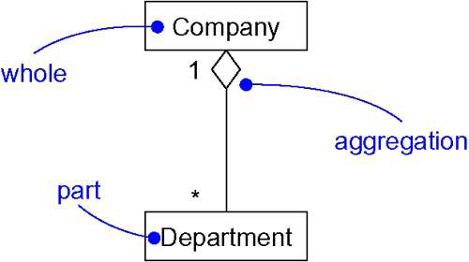
Aggregation

Slide 21
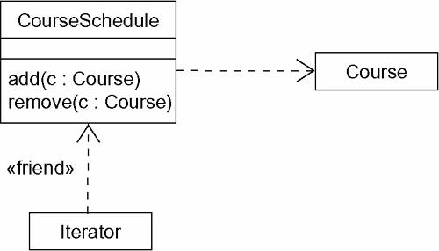
Dependency Relationships

Slide 22
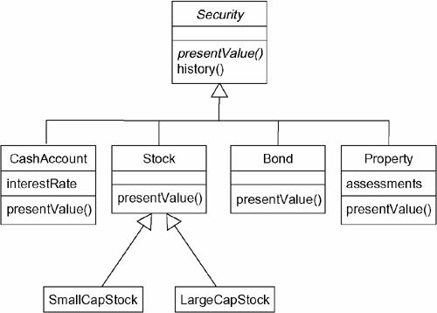
Inheritance Relationships

Slide 23
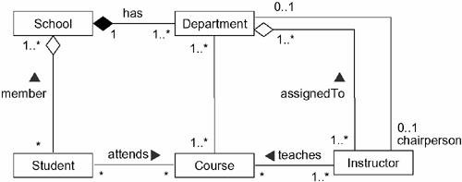
Structural Relationships

Slide 24
Typically, we'll view the static parts of a system using one of the four following diagrams:
1. Class diagram
2. Object diagram
3. Component diagram
4. Deployment diagram

Slide 25
We'll often use five additional diagrams to view the dynamic parts of a system:
1. Use case diagram
2. Sequence diagram
3. Collaboration diagram
4. Statechart diagram
5. Activity diagram

Slide 26
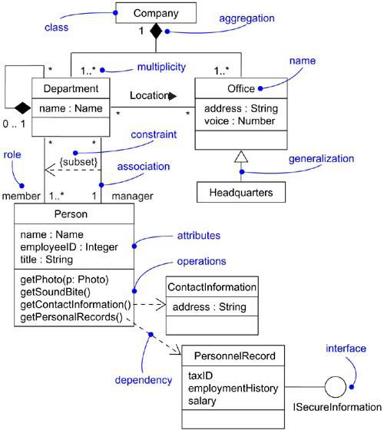
A Class Diagram

Slide 27
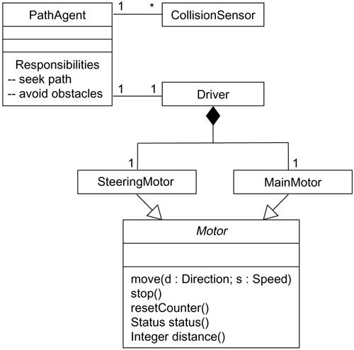
Modeling Simple Collaborations

Slide 28
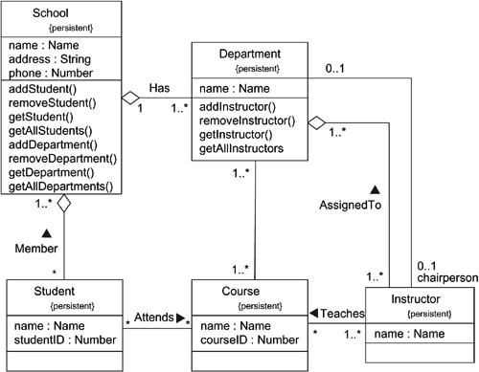
Modeling a Schema

Slide 29
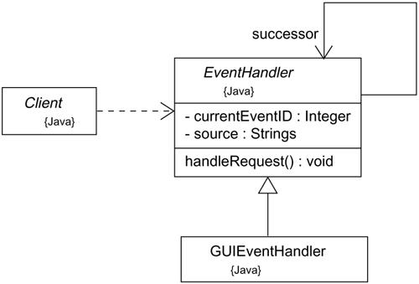
Forward Engineering

Slide 30
Forward engineering the class EventHandler yields the following code:
public abstract class EventHandler {
EventHandler successor;
private Integer currentEventID;
private String source;
EventHandler() {}
public void handleRequest() {}
}

Slide 31
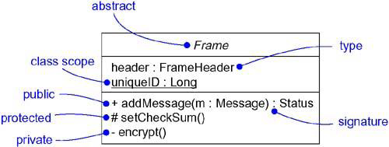
Advanced Classes

Slide 32
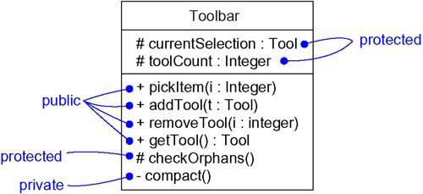
Visibility

Slide 33
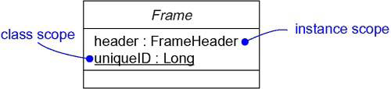
Owner Scope

Slide 34
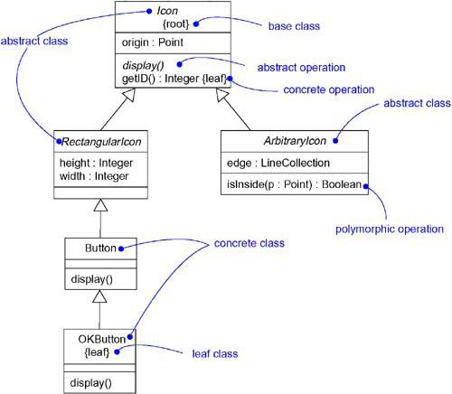
Abstract and Concrete Classes and Operations

Slide 35
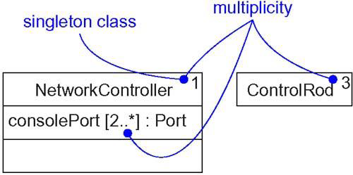
Multiplicity

